Slide 1
Faculty Opinions （原F1000 Prime)
用户使用指南
Website:https://facultyopinions.com/prime/home

Slide 2
Faculty Opinions brings together the opinion of over 8,000 leading life scientists to highlight articles they think are important, groundbreaking and essential reading for scientists.
Discover
Peer-nominated Faculty Members continually filter the literature for you, to select articles they find particularly important and interesting, so you don’t have to.
Gain Insight
Articles are assigned a star rating, categorized, and evaluated in a short, opinionated commentary outlining the value of the science to the wider community.
Customize Alerts
Create detailed and personalized search parameters, sign up for customized email alerts so you can easily access the article recommendations relevant to your fields of interest.

Slide 3
1. Sign-In…(1)
1
Subscribed Institution access within IP range
Register / Sign In personal account for saving search results

Slide 4
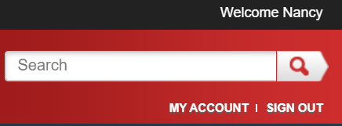
1. Sign-In…(2)
Register / Sign In personal account for saving search results

Slide 5
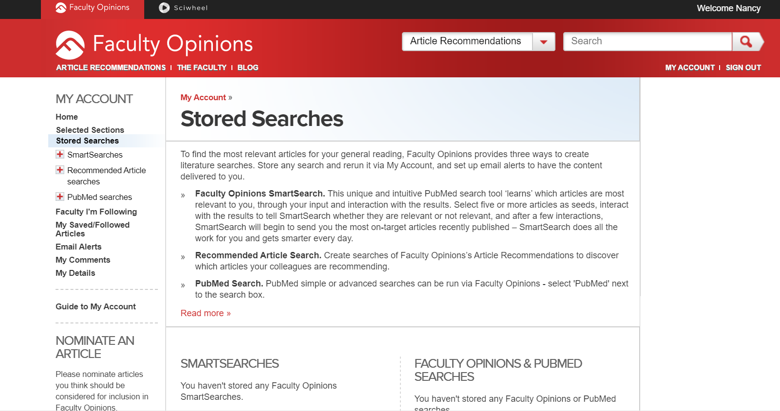
2. My Account
2
Home
Selected Sections
Stored Searches
Faculty I’m Following
My Saved/Followed Articles
Email Alerts
My Comments
My Details
Nominate an article to Faculty Opinions

Slide 6
3. Faculty Opinions ~My Homepage…(1)
3

Slide 7
3. Faculty Opinions ~My Homepage…(2)
首頁支援個人化設定。透過 關鍵字搜尋及主題區搜尋即 能回應目前出版中相關聯的 論文及專家的評選。

Slide 8
3. Faculty Opinions ~My Homepage…(3)

Slide 9
4. Article Recommendations - search Faculty Opinions / PubMed…(1)
4

Slide 10
4. Article Recommendations - search …(2)
4
Save to
”MYACCOUNT”
Filters: 1.Rated 2.Classified 3.Article Type
Recommended in
Artilce Published
44 results
1.Most Viewed 2.No. of recommendations (highest)
3. No. of recommendations (lowest) 4.Publication date
5. Recommendation
Date

Slide 11
4. Article Recommendations - search …(3)
Save name of search and email alerts

Slide 12
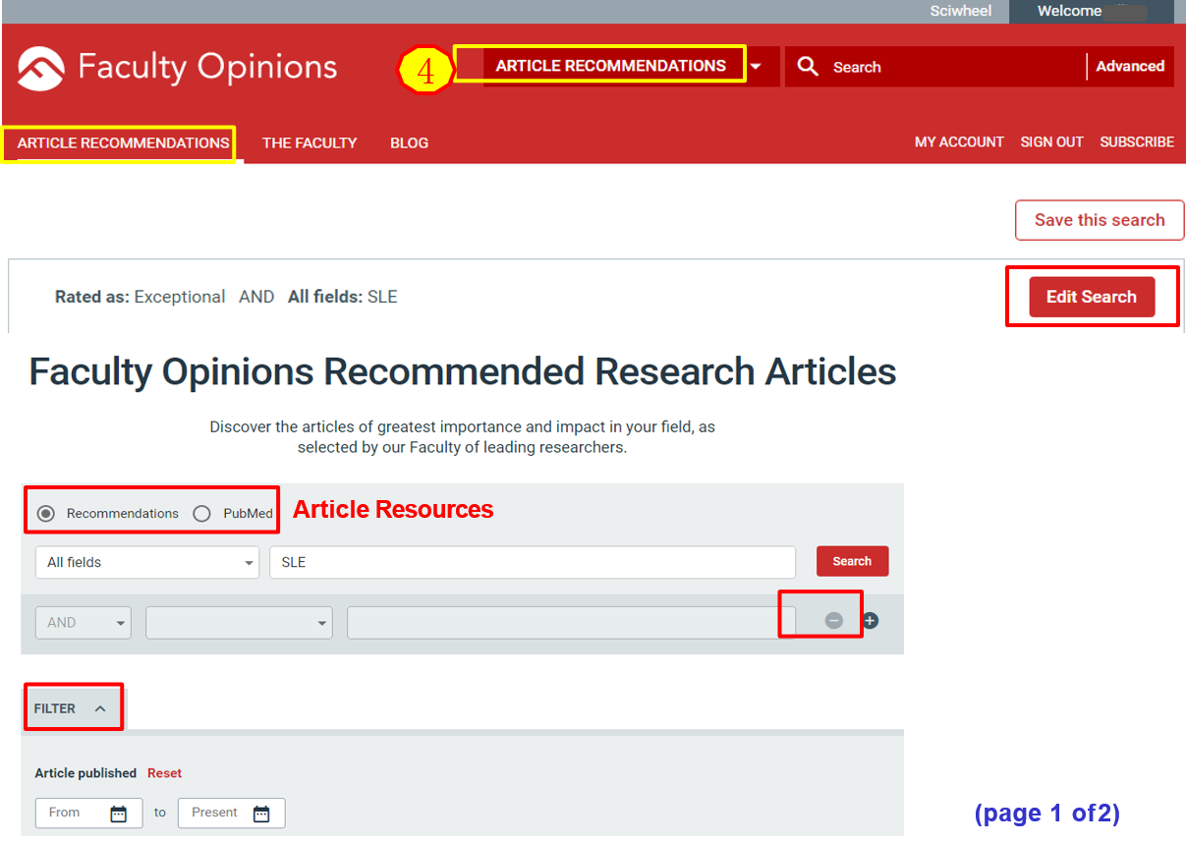
4. Article Recommendations - search …(4-1)

Slide 13
4. Article Recommendations - search …(4-2)
(page 2 of 2)

Slide 14
4. Article Recommendations - search …(5)
4
Filtered search results

Slide 15
4. Article Recommendations – Advanced Search
4
Same as searching steps of
(4-1)~(4-2)

Slide 16
4. Article Recommendations –Recommendations
4

Slide 17
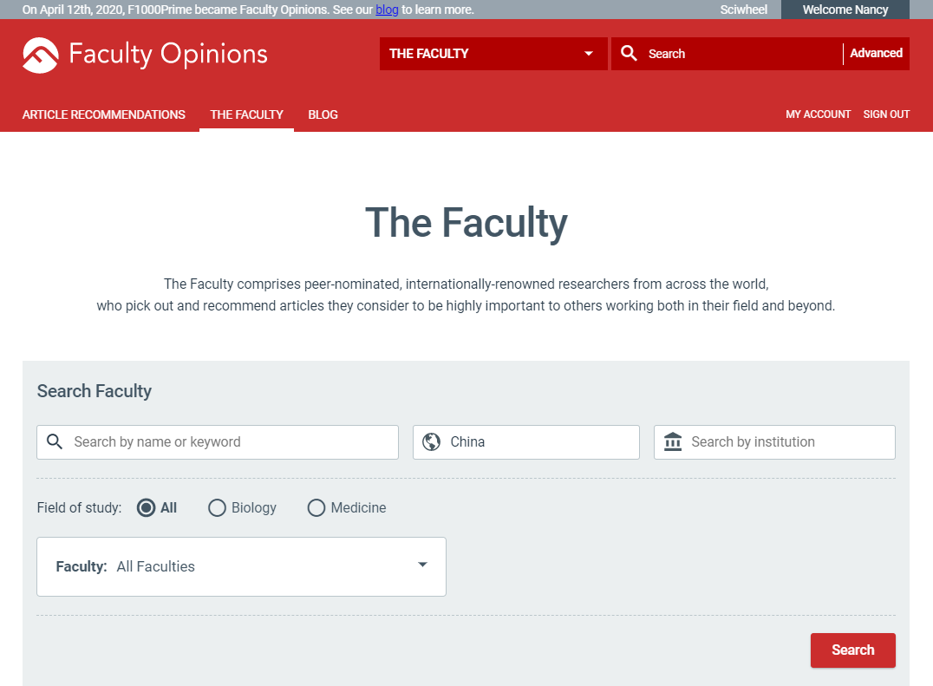
5. The Faculty…(1)
5
Search by Name/Country/Institution → e.g. “China”

Slide 18
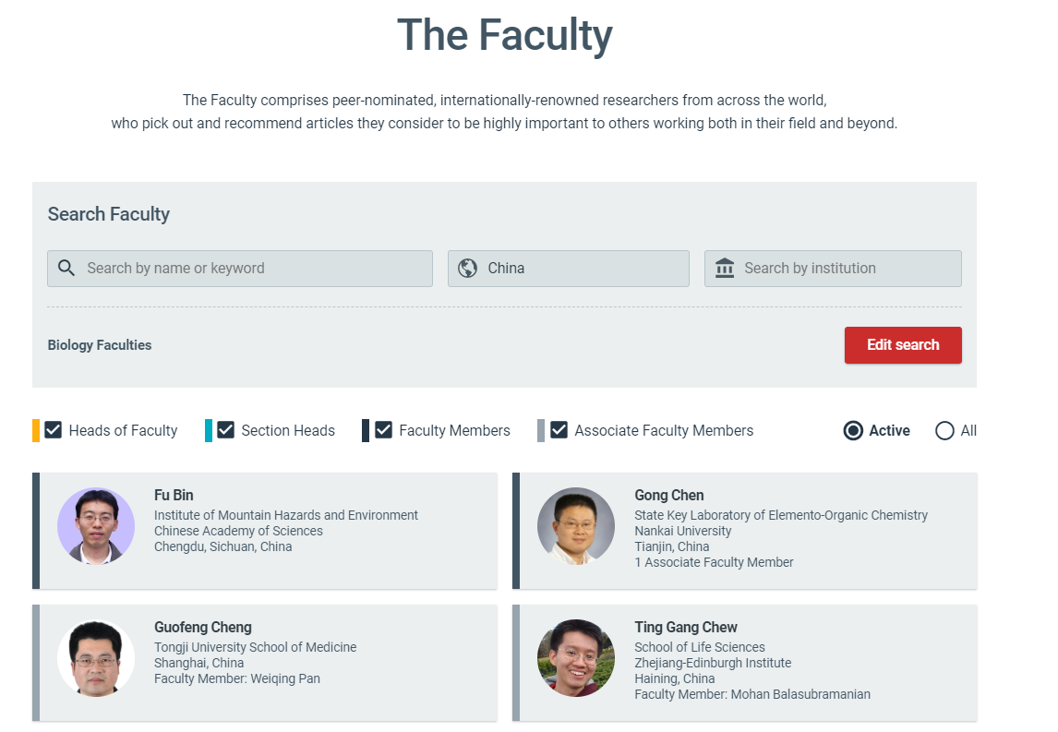
5. The Faculty…(2) Faculty from“Taiwan”
TTL: 20

Slide 19
5. The Faculty …(3) Faculty Structure
Heads of Faculty are the most eminent individuals in their field overseeing each of the Faculties across biology and medicine. They divide their Faculty into its major disciplines – Sections – and appoint Section Heads for each of these fields.
Section Heads are leading authorities in their respective discipline, who provide editorial oversight and appoint Faculty Members to review the literature to ensure the full breadth of the field is covered.
Faculty Members are leading experts, who recommend the most noteworthy articles in their fields,
sharing their perspective and opinion to help you understand the key points and context.
Associate Faculty Members are appointed by Faculty Members to assist them with the recommendation process. They also scan the tables of contents of the major general and specialist journals to ensure that the literature is systematically and comprehensively covered.
The Faculty comprises peer-nominated, internationally-renowned researchers from across the world, who pick out and recommend articles they consider to be highly important to others working both in their field and beyond.

Slide 20
8. Faculty Opinions @PubMed…(1)
Registered with PubMed, go to ‘My NCBI’ and follow these steps:
Go to Filters, PubMed
Click Manage Filters
Under Browse/Search for PubMed Filters, click LinkOut
Search for Faculty Opinions
Click Filter and Link Icon

Slide 21
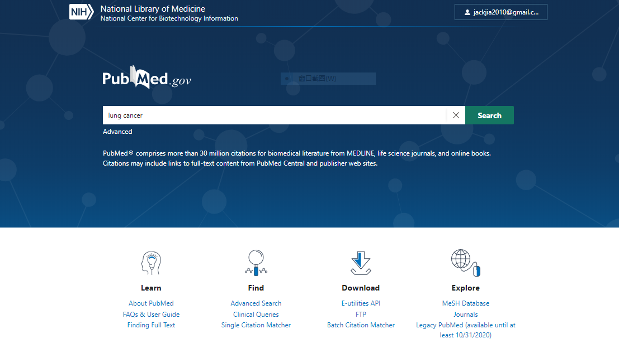
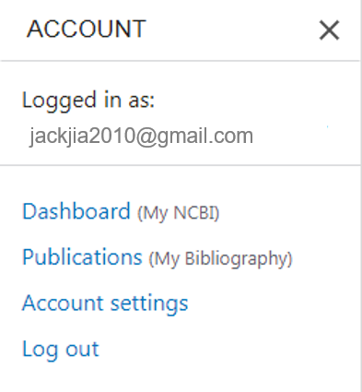
8. Faculty Opinions @PubMed…(2)

Slide 22
8. Faculty Opinions @PubMed…(3)

Slide 23
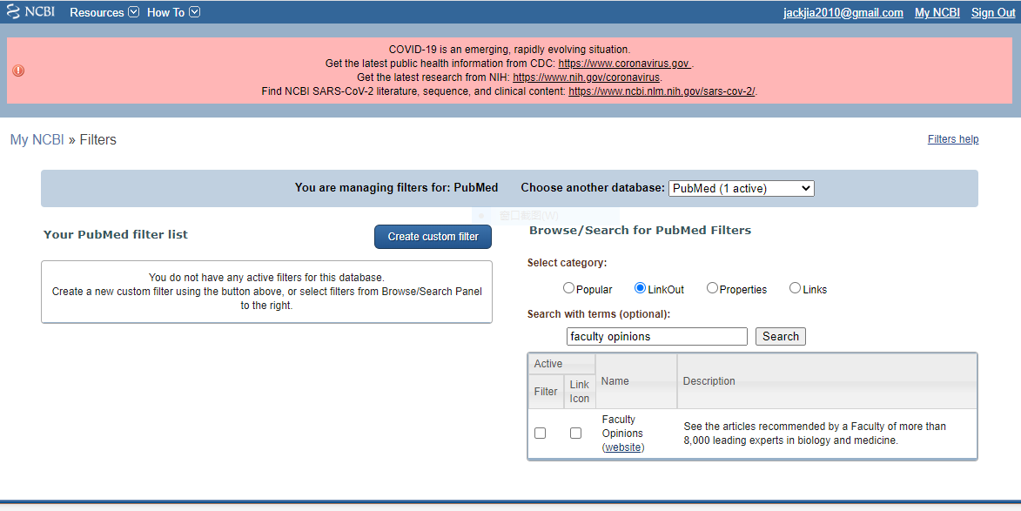
8. Faculty Opinions @PubMed …(4)

Slide 24
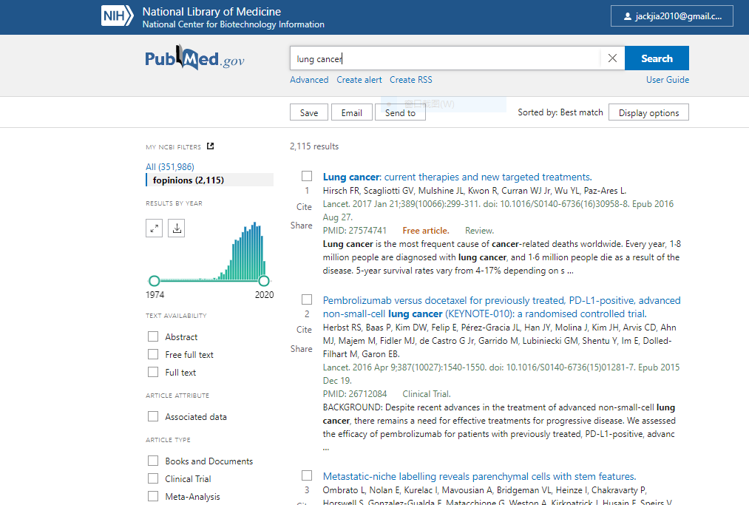
8. Faculty Opinions @PubMed …(5)

Slide 25
Thanks

