Slide 1
Melanoma Cell-Intrinsic PD-1 Receptor Functions
Promote Tumor Growth
Cell
2015.9
WEI BEIWEN
2015.11.6

Slide 2
BACKGROUND
Immune checkpoints are crucial regulatory pathways that maintain immune homeostasis by modulating the amplitude and quality of several adaptive and innate effector mechanisms in favor of immunogenic tolerance.

Slide 3
Death 1 (PD-1) is a prominent checkpoint receptor that, upon engagement by its ligands, PD-L1 (also known as B7-H1) or PD-L2 (also known as B7-DC), dampens T effector functions by inhibiting signaling downstream of the T cell receptor (TCR).

Slide 4
A number of antibody-based therapeutics targeting the PD-1:PD-L1 axis have entered clinical development or have been approved for melanoma therapy.

Slide 5
FDA approved two anti-PD-1 antibodies, nivolumab and pembrolizumab, for the treatment of patients with advanced melanoma who are no longer responding to other drugs.

Slide 6
RESULTS

Slide 7
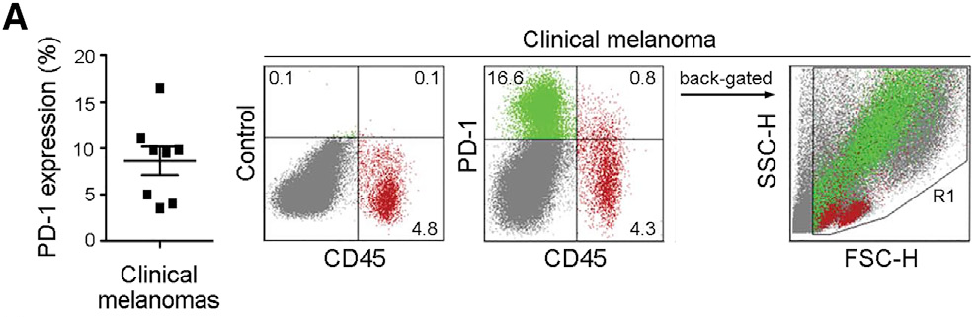
1. Melanomas Frequently Contain PD-1-Expressing Cancer Subpopulations

Slide 8
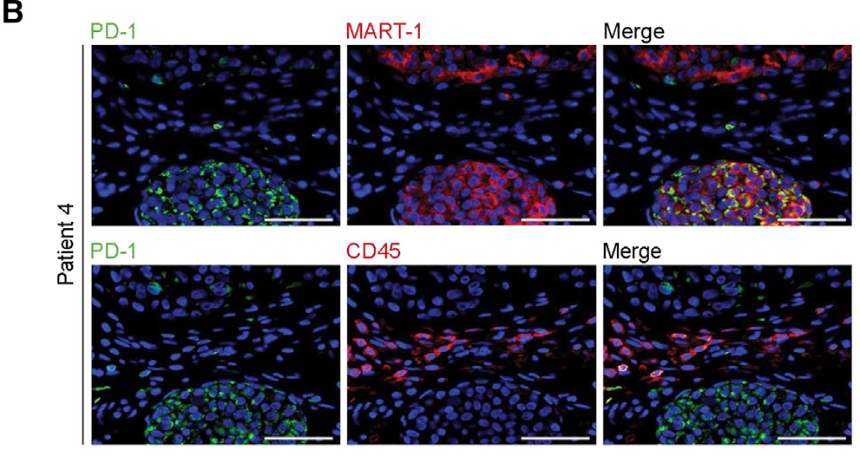

Slide 9
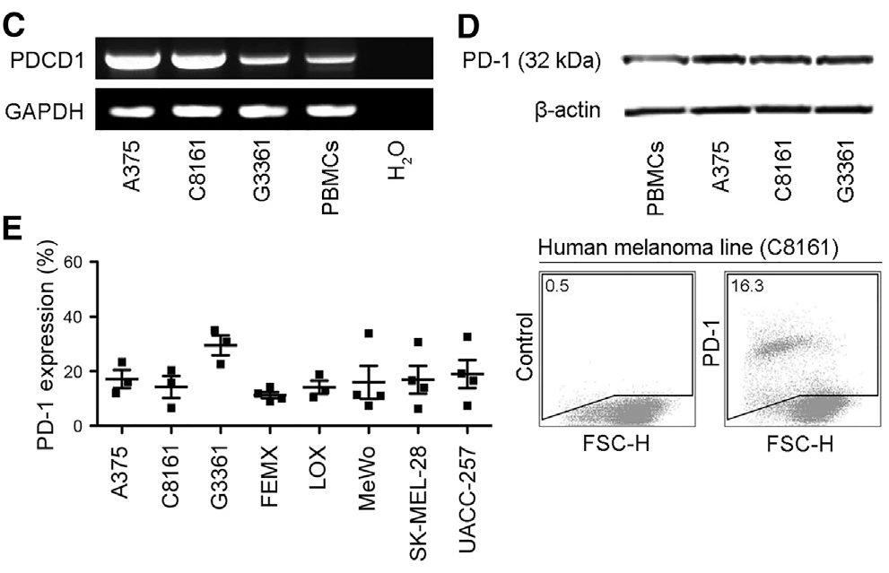

Slide 10
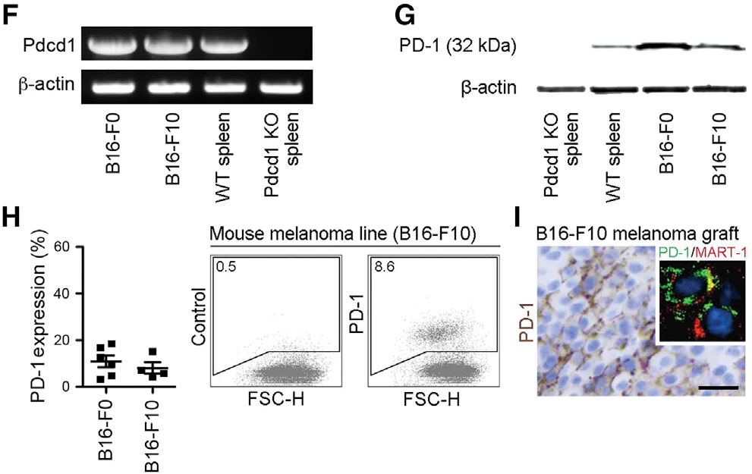

Slide 11
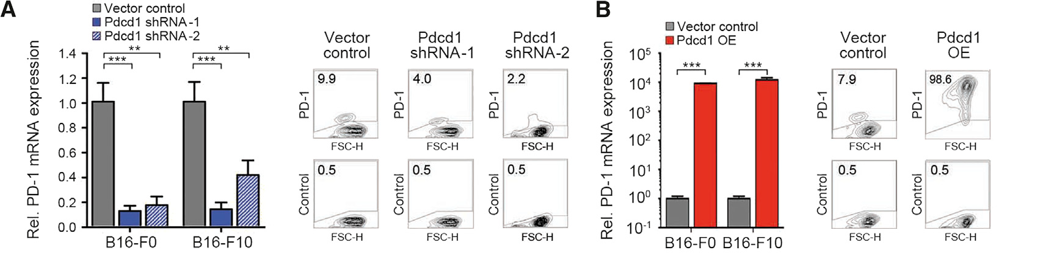
2. Melanoma-Expressed PD-1 Promotes Murine Tumor Growth

Slide 12
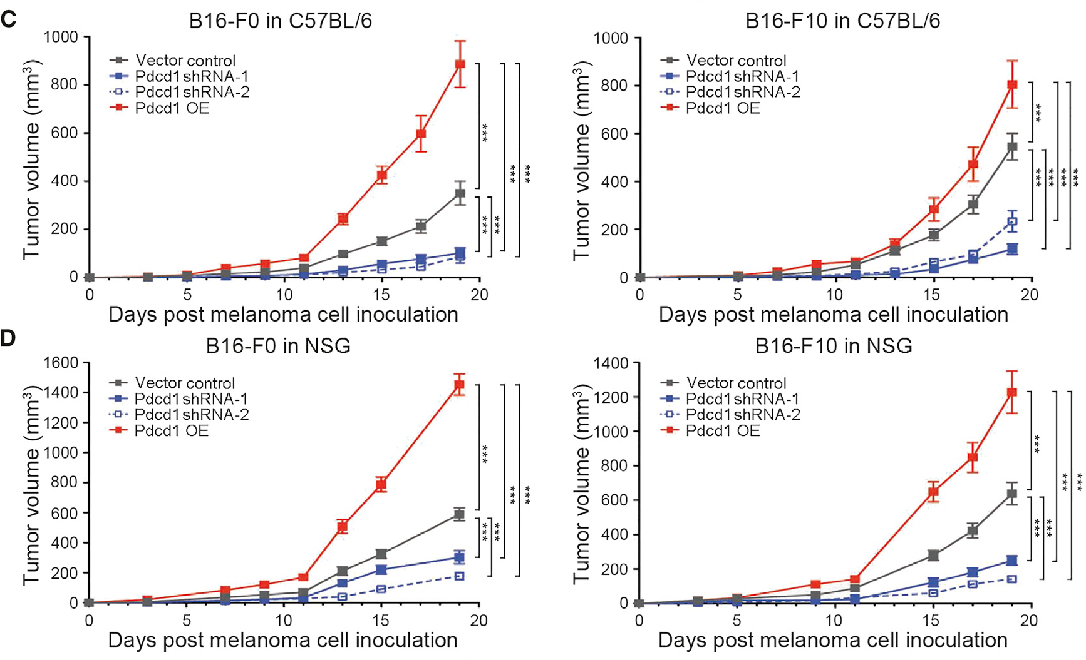

Slide 13
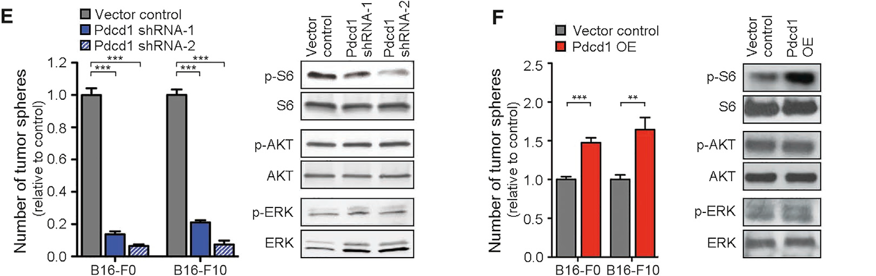

Slide 14
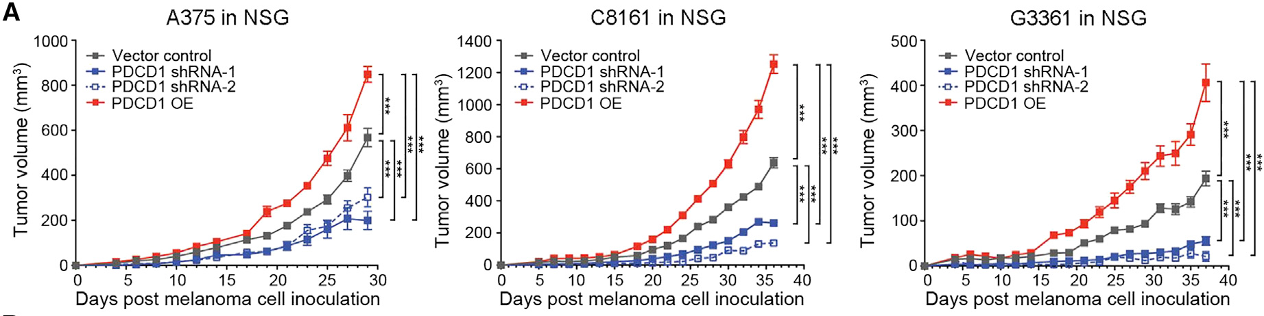
3. Tumor Cell-Intrinsic PD-1 Signaling Is Required for Efficient Murine Melanoma Growth

Slide 15
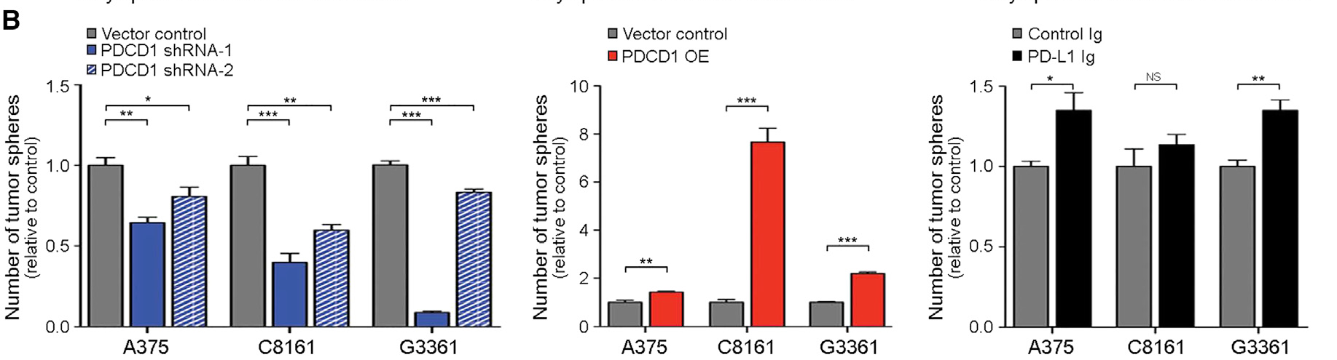

Slide 16
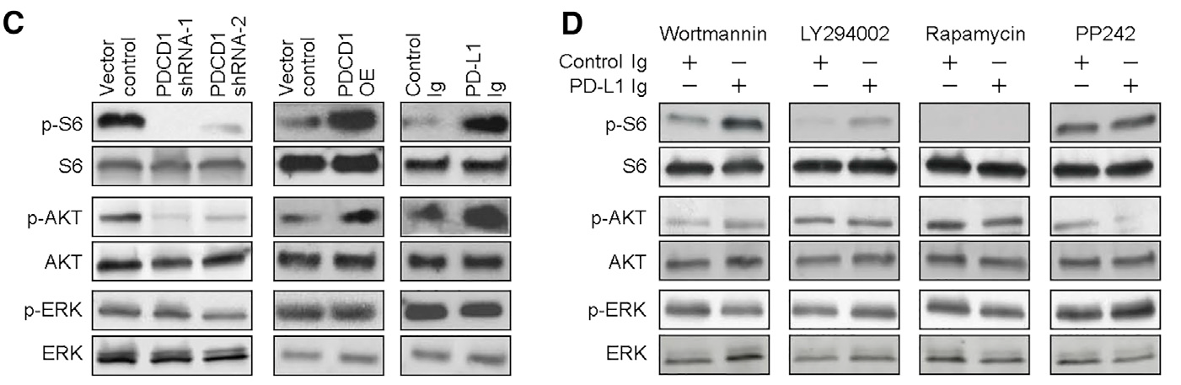

Slide 17
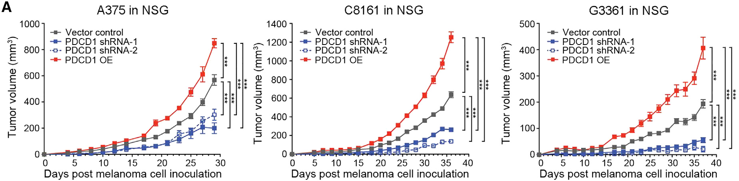
4. Melanoma Cell-Intrinsic PD-1 Enhances Human Tumor Xenograft Growth

Slide 18
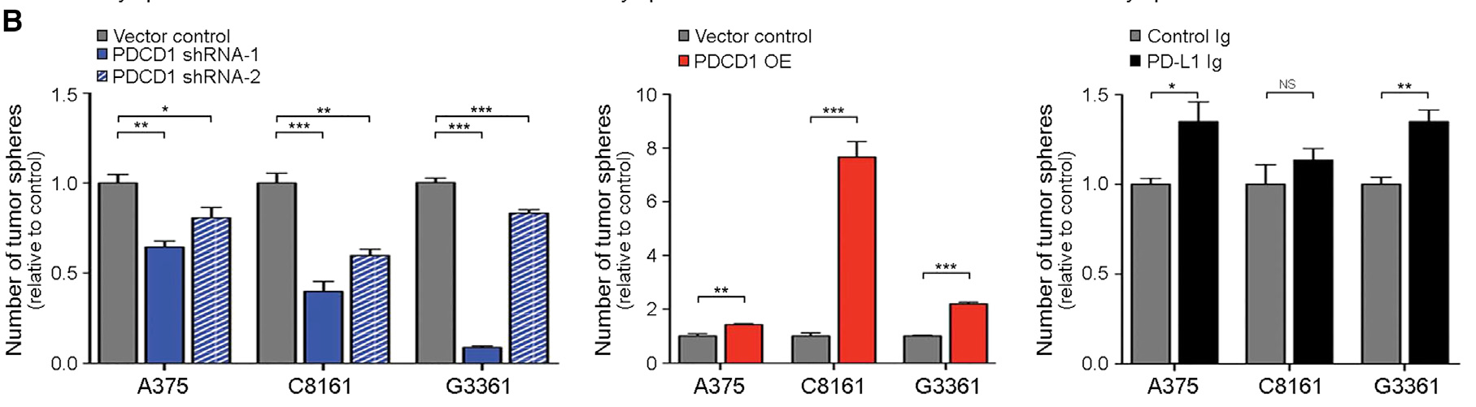

Slide 19
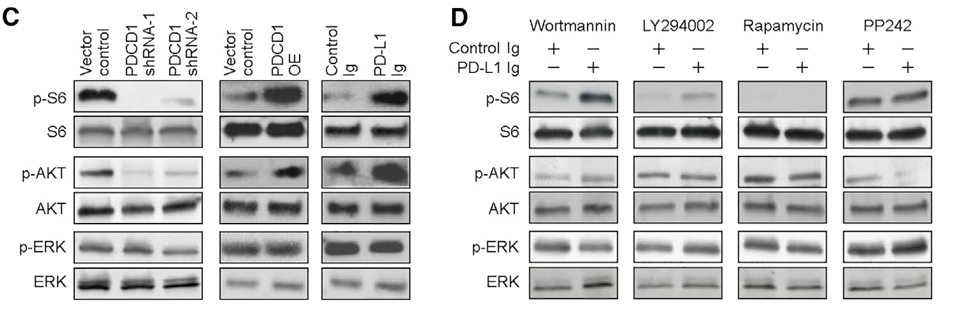

Slide 20
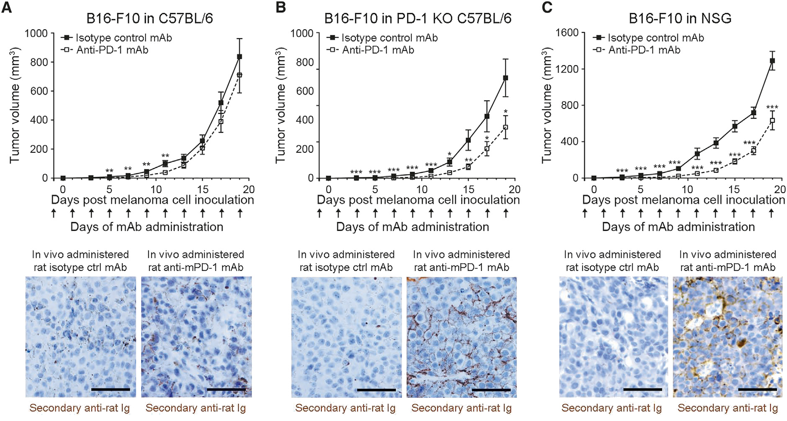
5. Antibody-Mediated Blockade of PD-1 on Melanoma Cells Inhibits Murine Melanoma Growth

Slide 21
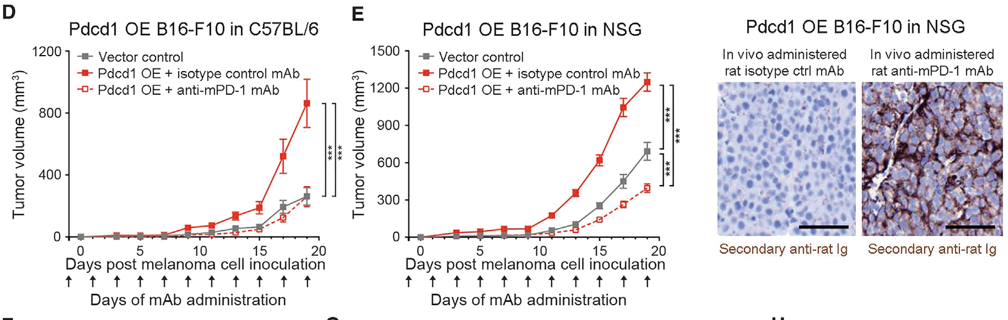

Slide 22
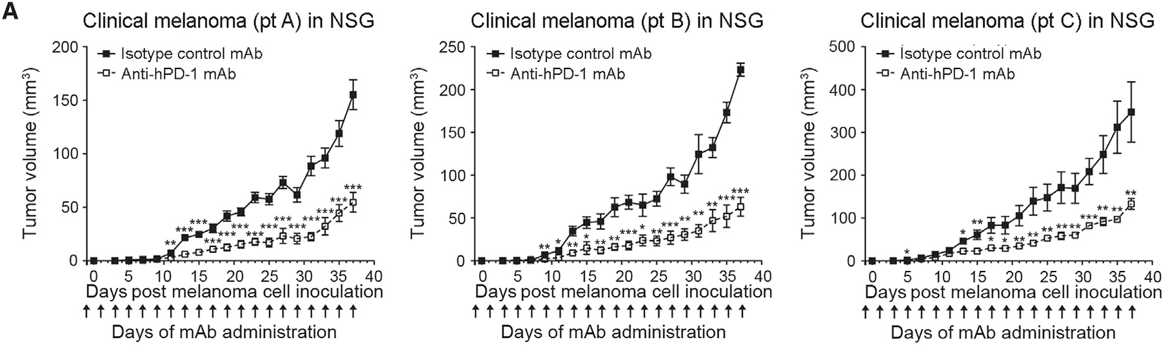
6. Antibody-Mediated PD-1 Blockade Inhibits Human Melanoma Xenograft Growth in Immunodeficient Mice

Slide 23
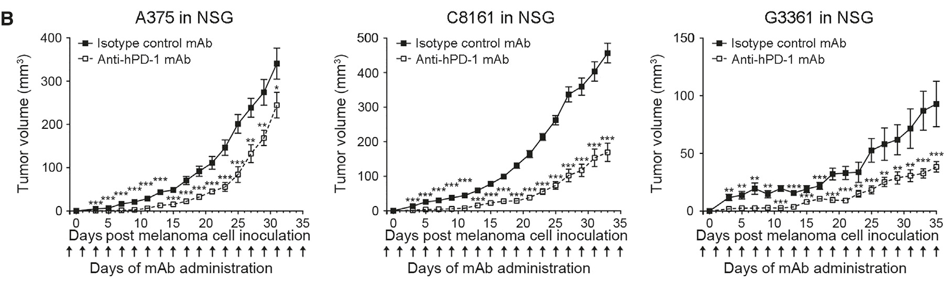

Slide 24
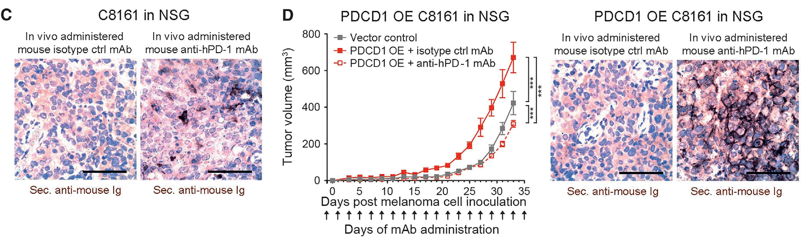

Slide 25
CONCLUSION

Slide 26
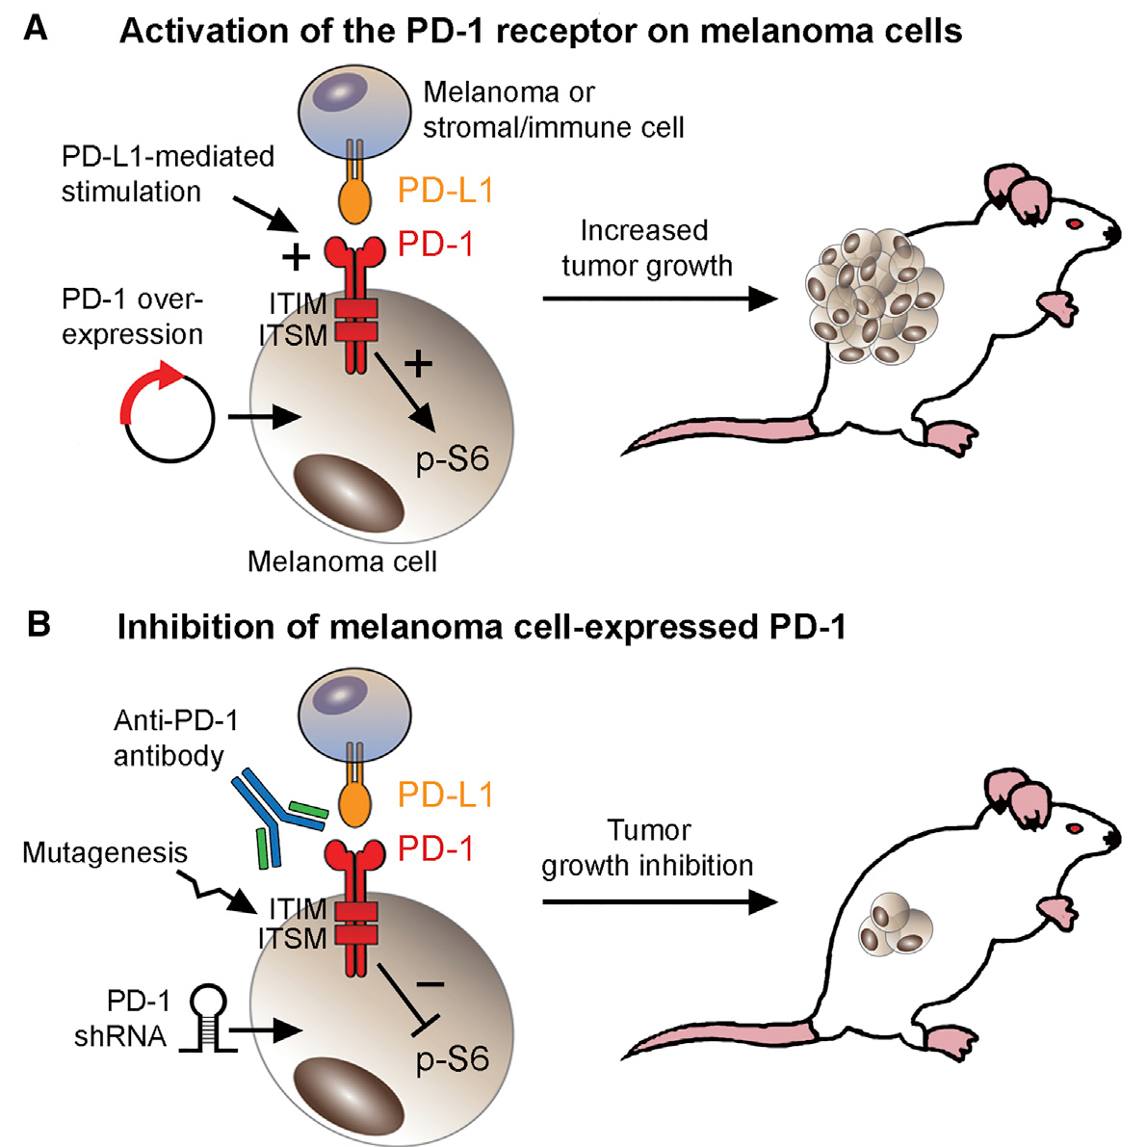
PD-1/PD-L1 signaling has cell-intrinsic functions in certain types of mouse and human tumors, boosting cancer growth and promoting tumorigenesis. This suggests that immunotherapy with PD-1 blockers may produce an effect on tumor growth that is separate from their effect on the immune response.

Slide 27
PD-1 expressed by melanoma cells as a tumor growth receptor and molecular mediator of melanoma cell-intrinsic mTOR signaling, serving to promote tumorigenesis in addition to its protumorigenic role when expressed by immune cells.

Slide 28
Recognition of melanoma-PD-1 receptor-driven tumorigenesis critically enhances our understanding of the mechanisms underlying melanoma progression and could contribute to the further refinement of PD-1-targeted therapies, for improved outcomes in patients with advanced stage cancer.

Slide 29
THANK YOU!

